Slide 1
Machine Learning CSE 445 Summer 2022

Slide 2
CSE 445 Lecture 1
Thinking about DATA
Sarnali Basak
Associate Professor
Dept. of Computer Science and Engineering,
Jahangirnagar University

Slide 3
Course Instructions for Summer 2022
All the reading material, course outline, video content (when applicable) will be available on the CANVAS.
Exam rules, mark distribution, project details and allocations will also be available on the CANVAS.
Contents are covered from Victor Lavrenko and Nigel Goddard, The University of Edinburgh.

Slide 4
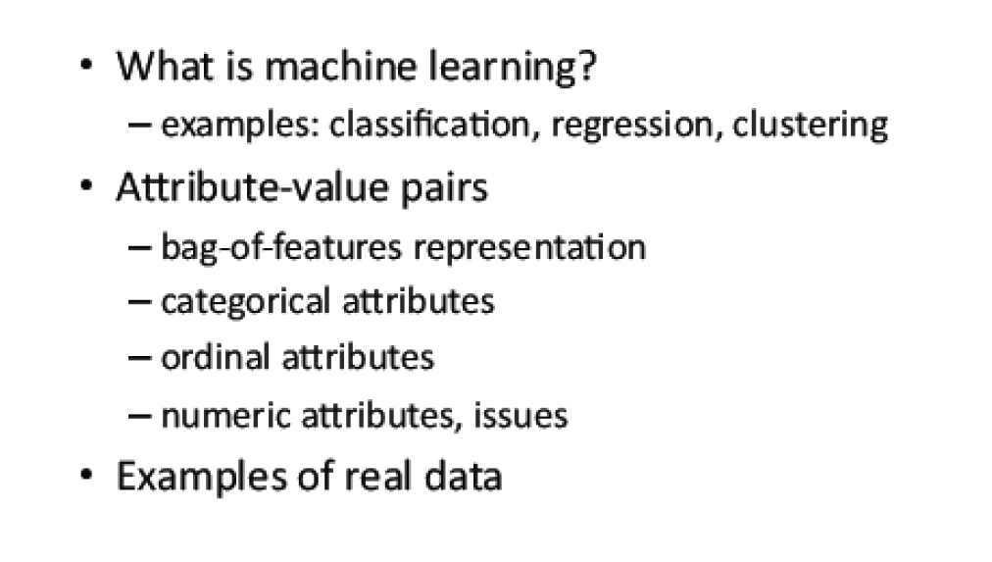
Overview

Slide 5
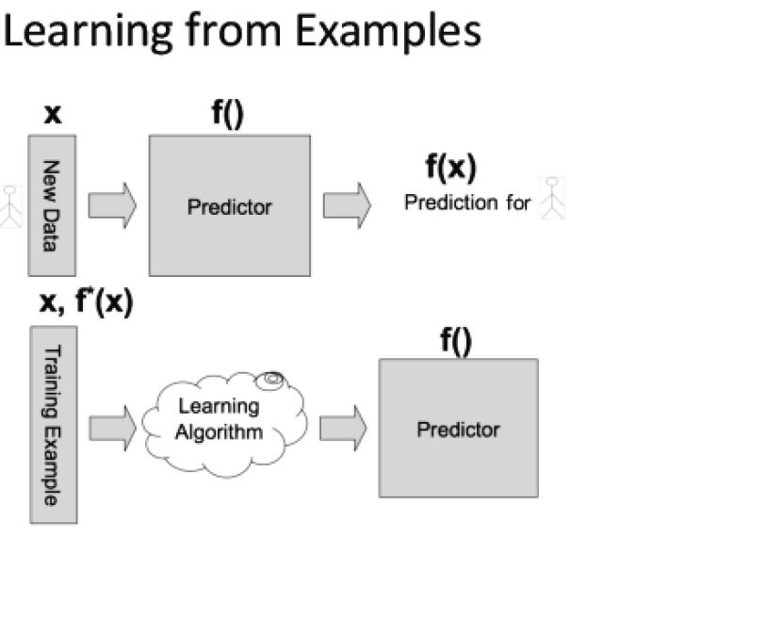
How does it work?

Slide 6
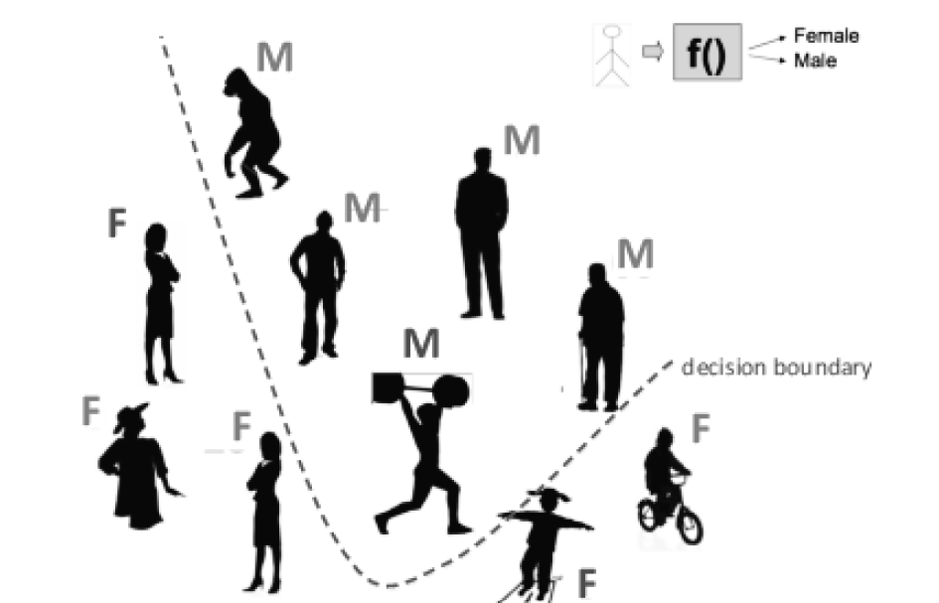
Classification(Supervised Learning)

Slide 7
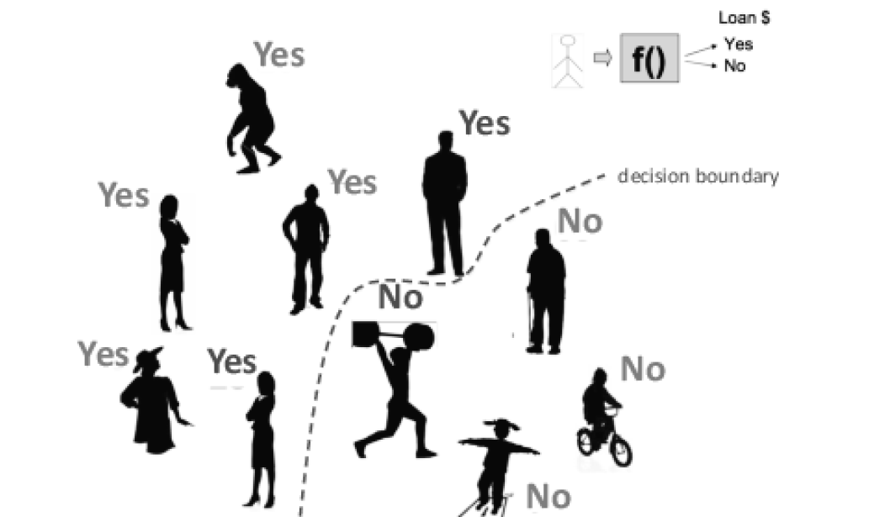
Classification (Supervised Learning for a different case)

Slide 8
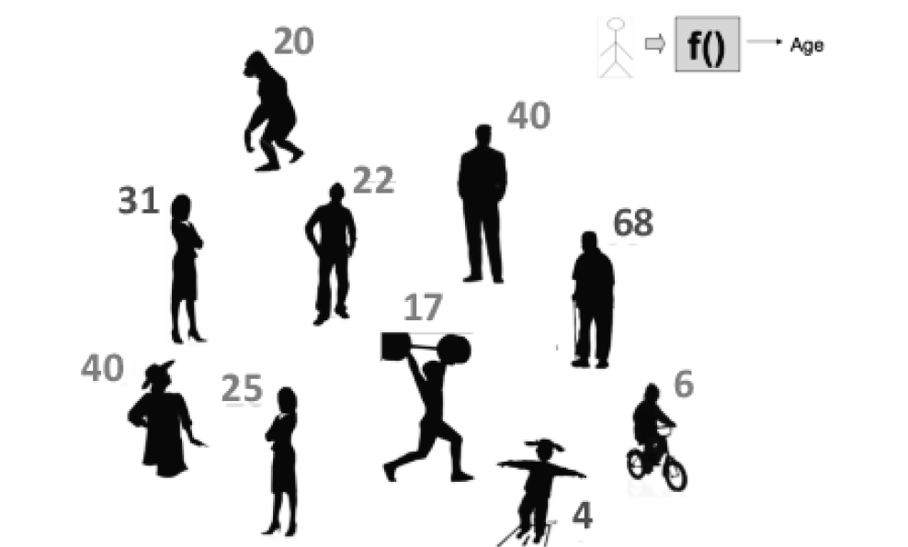
Regression (Supervised Learning)

Slide 9
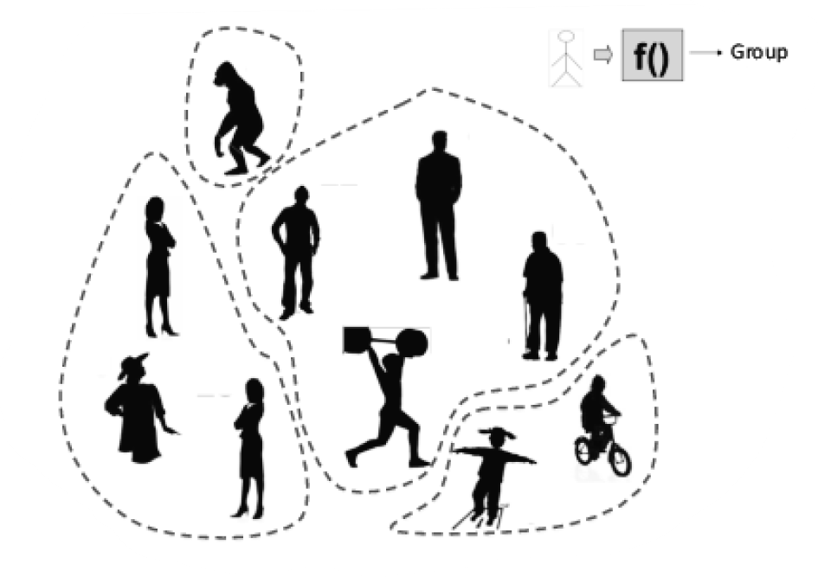
Clustering(Unsupervised Learning)

Slide 10
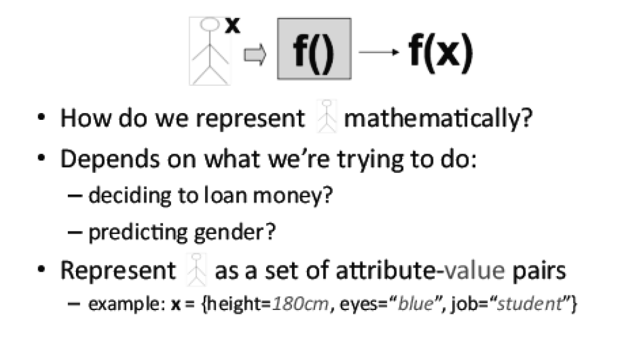
Representing Data

Slide 11
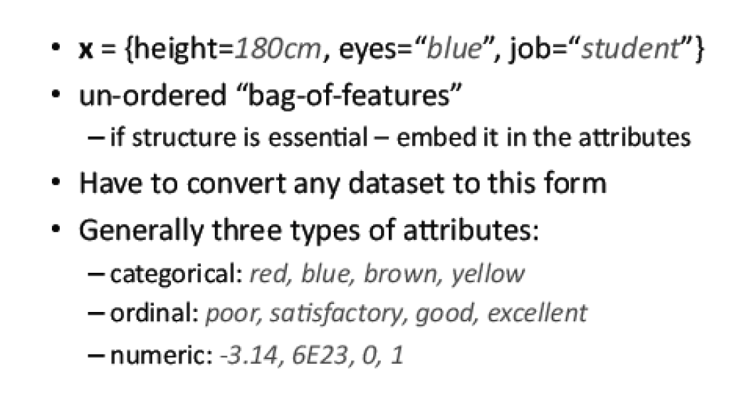
Attribute-value Pairs

Slide 12
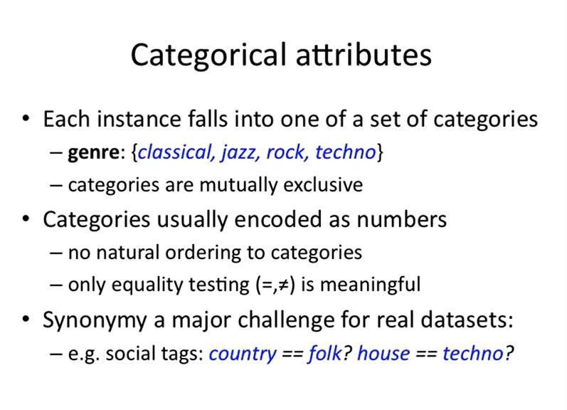

Slide 13
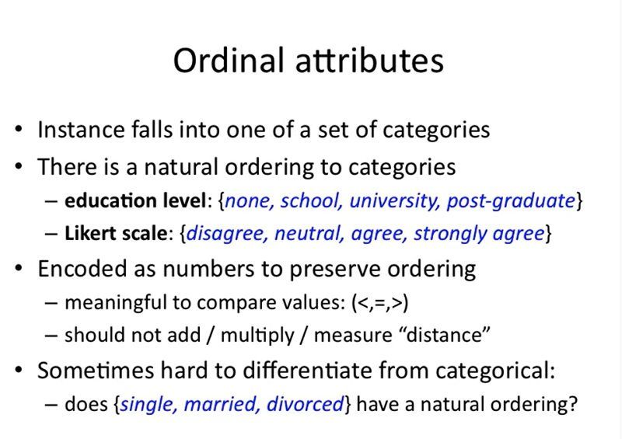

Slide 14
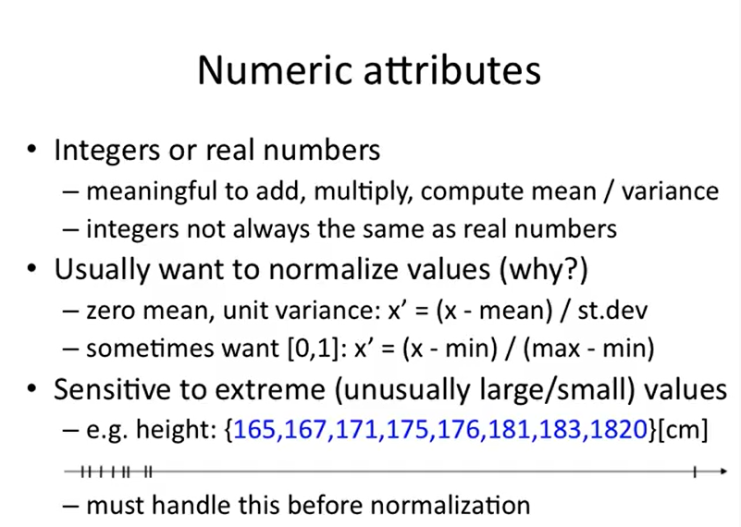

Slide 15
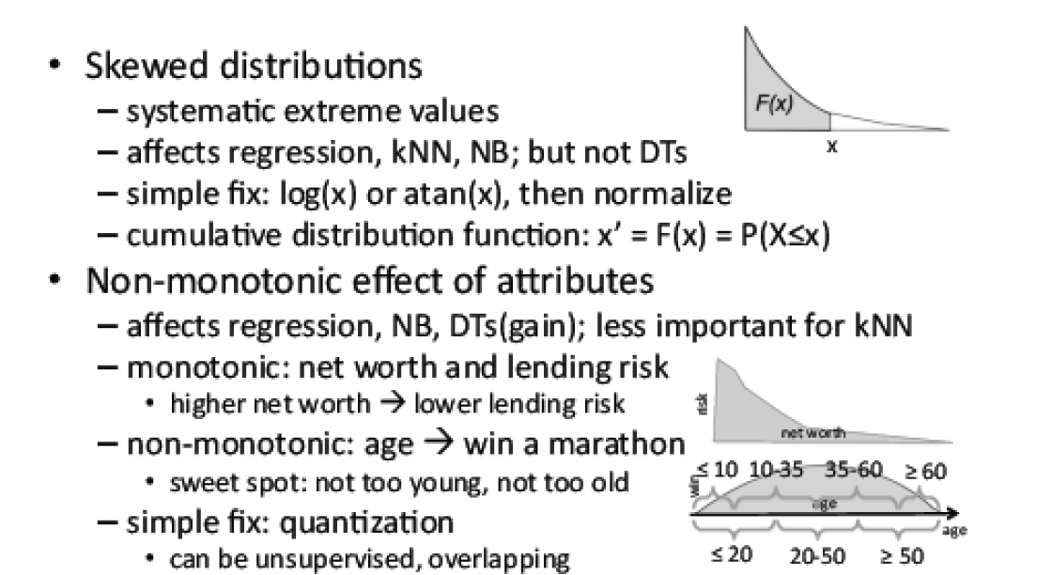
Numeric Attributes: Issues

Slide 16
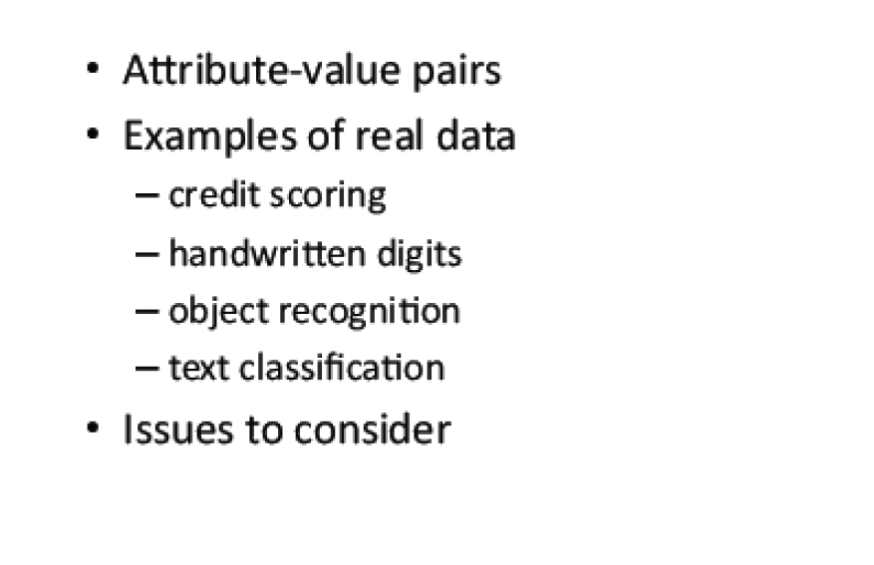
Overview

Slide 17
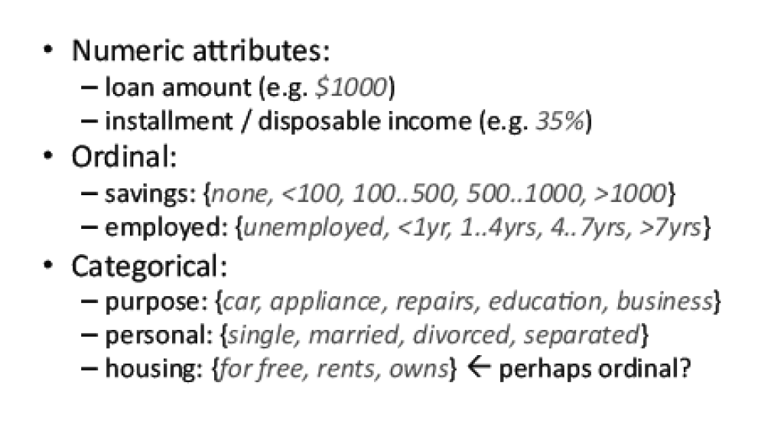
Example: Credit Scoring

